Slide 1
Selva Ragul Kumar
2021503048
Naan Mudhalvan Project
NM ID: 0CBFC4B98257EB199B749C8490E78E52

Slide 2
Cycle GAN based Image-to-Image Generation

Slide 3


AGENDA
Introduction to Generative Adversarial Networks (GANs).
Overview of usage of Cycle GAN, and its power to utilize Unpaired Data.
Detailed exploration of Cycle GAN architecture and its components, and its possible use to translate a type of image to another type.
Overview of Horse2Zebra dataset and its possible uses.
Performing a horse to zebra and vice-versa translation using the model.
Evaluation and analysis of the generated images, discussing challenges and future directions.
3/21/2024 Annual Review

Slide 4

PROBLEM STATEMENT In this project, Cycle Generative Adversarial Networks (Cycle GAN) are utilized to translate images between horses and zebras, and vice versa. The primary challenge lies in training without paired data, meaning corresponding images in both domains are unavailable. To overcome this, two generators are simultaneously trained, each mapping images between the two domains and back again. The key objective is to ensure that the generated images maintain the original spatial characteristics while successfully translating desired features. This is achieved through the implementation of cycle consistency and identity loss functions. The project aims to demonstrate the effectiveness of Cycle GAN in image translation tasks without the reliance on paired datasets, offering versatile solutions for various applications.

Slide 5
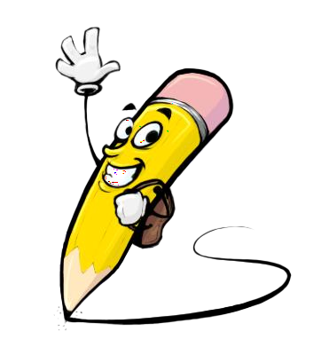
Project Overview: GANs for Human Face Image Generation
Introduction: Exploring Cycle Generative Adversarial Networks (Cycle GANs) for image translation tasks.
Dataset: Utilizing Horse2zebra Dataset for training and evaluation.
Methodology: Employing a Cycle GAN architecture comprising two generators and two discriminators for simultaneous training in both directions of image translation.
Implementation Steps: Preprocessing of image data, design and configuration of Cycle GAN architecture, training procedure including cycle consistency and identity loss functions, and assessment of translated image quality.
Expected Outcomes: Successful translation of images between horse and zebra domains, insights into the capabilities and limitations of Cycle GANs for unpaired image translation tasks.

Slide 6

WHO ARE THE END USERS?
Entertainment Industry: Film, TV, and game developers seeking realistic scene generation for immersive storytelling experiences and visual effects, like realistic to anime content.
Photography and Design Studios: Professionals looking to experiment with artistic transformations or stylizations for creative projects and visual content creation.
Research Institutions: Academics and scientists exploring image-to-image translation techniques for various scientific investigations and experiments.
Urban Planning and Architecture: Urban planners and architects interested in simulating environmental changes or architectural designs for urban development projects.
These users can leverage Cycle GANs to address a wide array of tasks, including style transfer, image enhancement, and content synthesis, across diverse domains and applications.

Slide 7

YOUR SOLUTION AND ITS VALUE PROPOSITION
Our Solution:
Implementation of Cycle Generative Adversarial Networks (Cycle GANs) for image translation from horse to zebra, and vice-versa.
Utilizing a dedicated horse-to-zebra dataset for training and evaluation, ensuring targeted and effective image translation.
Value Proposition:
High-Quality Image Translation: Our Cycle GAN model excels in producing realistic transformations between horse and zebra images, maintaining original spatial characteristics.
Efficiency and Scalability: The training process is streamlined, enabling scalability and the generation of large volumes of translated images.
Versatility: The code can cater to applications requiring similar transformations, offering tailored solutions for a range of use cases such as artistic rendering, visual effects, and experimental research.

Slide 8
THE WOW IN YOUR SOLUTION Incredibly Realistic Image Translation: Our Cycle GAN model generates horse and zebra images that are remarkably true to life, surpassing conventional expectations for image translation. Unparalleled Detail and Fidelity: It meticulously captures intricate features and textures of horses and zebras, ensuring unparalleled fidelity and realism in the translated images. Instantaneous Transformation: Delivering swift and seamless image translation, our model revolutionizes the process, enabling rapid production and iteration of transformed images. Boundless Creative Opportunities: With its ability to seamlessly translate between horse and zebra domains, our solution opens up boundless creative possibilities, empowering users to innovate and explore new storytelling avenues, artistic expressions, and design concepts.

Slide 9
MODELLING
Cycle Generative Adversarial Network:
Dual Generators: CycleGAN employs two generators—one to convert images from domain A to domain B, and another to reverse this process, transforming images from domain B back into domain A.
Cyclic Consistency: The architecture maintains cycle consistency by ensuring that images translated between the two domains can be reconstructed back to their original form, promoting meaningful and coherent mappings between the domains.
Training Data:
Leveraging the Horse2Zebra dataset comprising of a 1000 horse and zebra images for training.
The dataset is meticulously preprocessed, undergoing resizing, cropping, and normalization procedures to ensure consistency and enhance image quality.

Slide 10
MODELLING
Architecture Design:
Generator: Comprising downsample layers, upsample layers, and residual block layers to translate images between domains.
Discriminator: Distinguishing between real and generated images by comparing their spatial dimensions and content.
Combined Model: Combining the generator and discriminator into a single model for training purposes. This combined model facilitates the training process in CycleGAN.
Training Process:
The training process involves alternating optimization of the generator and discriminator networks through iterative backpropagation.
The training process utilizes multiple loss functions to guide the model in translating horse images to zebra images and vice versa. These loss functions include MSE for overall image similarity, and MAE for both pixel-wise and feature-wise differences.
A higher weight is assigned to the feature-wise MAE losses (10 times the pixel-wise MAE loss) to prioritize the preservation of important features during image translation.
The Adam optimizer is employed with a learning rate of 2e-4 and a beta_1 value of 0.5. This choice and configuration of the optimizer allow it to converge towards a rough solution within 25 epochs (Small number due to lack of computational power).

Slide 11
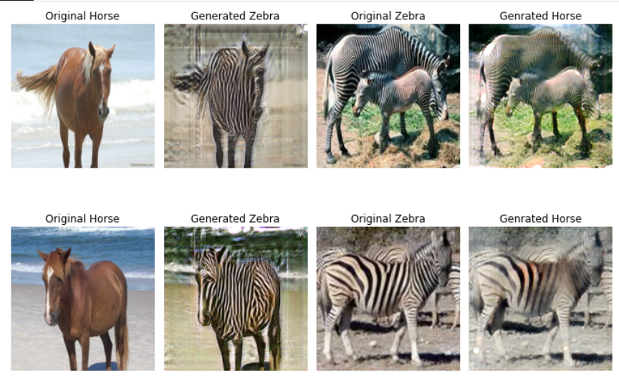
RESULTS

Slide 12
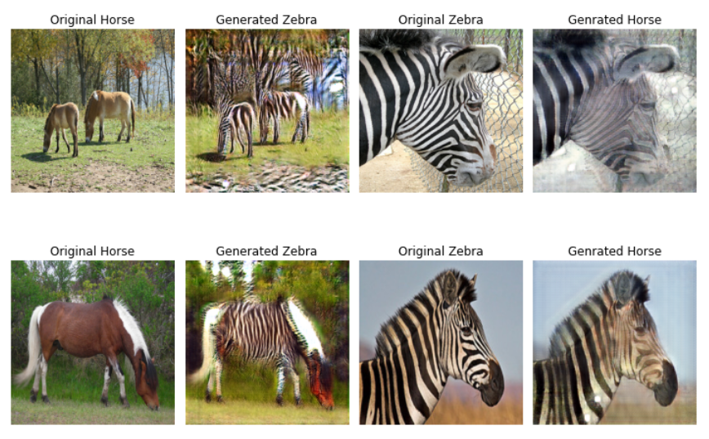
RESULTS

